Slide 1
Wheelchair fall detection
Under the guidance of Prof. Bincy Joseph
By
Abhishek Bhattacharjee(8796), Aaron Carvalho (8799),
Jaydeep Patil (8825) and
Abhay Rajbhar (8832)

Slide 2
Table of Contents
Objectives
Literature survey
Block Diagram
Flowchart
Circuit Diagram
Components
Test Plots
Implementation details
Video
Conclusion
References

Slide 3
Objectives
To design a system which is able to detect fall on the wheelchair.
The system then should be able to send a distress single to the family member of the patient.
To design a user friendly system without causing disturbance to the activities of daily living of elderly people .

Slide 4
LITERATURE SURVEY
Reference Number | Remarks
[1] | Various different approaches to fall detection and shortcoming of pi camera vision range
[2] | People end up discarding wheelchairs and unable to repair it. The scope of wheelchair and assistive technology
[3] | Study on threshold values for accelerometer and gyrometer used especially on electric wheelchair for fall detection
[4] | Approach towards the project
[5] | How to implement IOT aspect in the system
[6] | Basic theory for a fall detection system
[7] | Approach towards architecture and design of the system
[8] | Embedded system used in controlling wheelchair from android phone

Slide 5
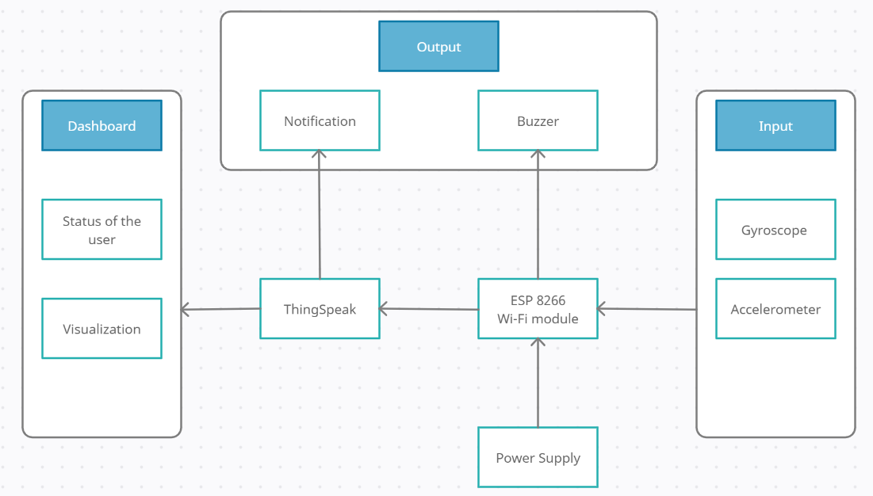
Block Diagram

Slide 6
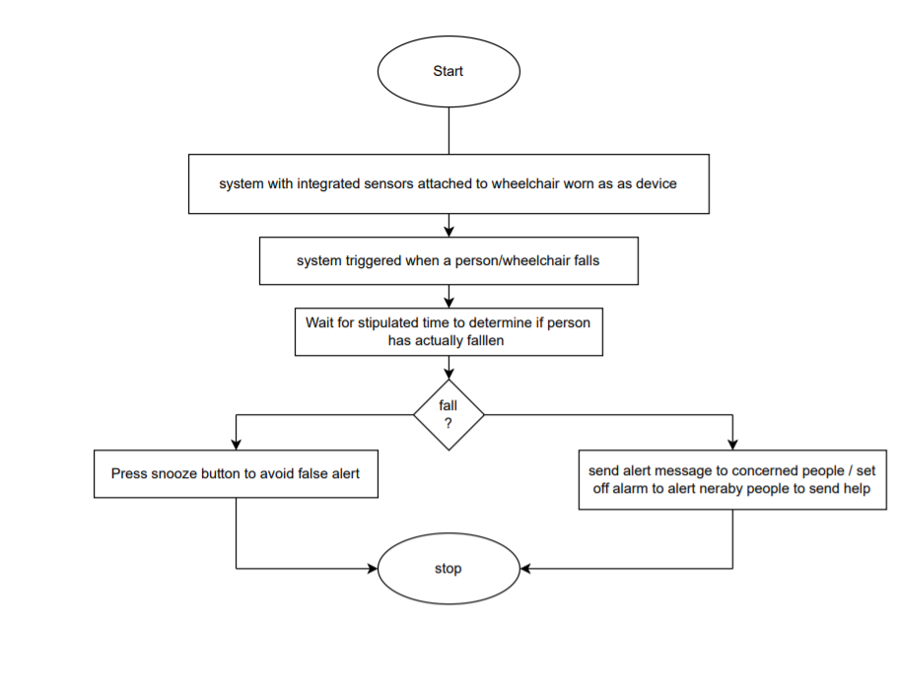
Flow chart

Slide 7
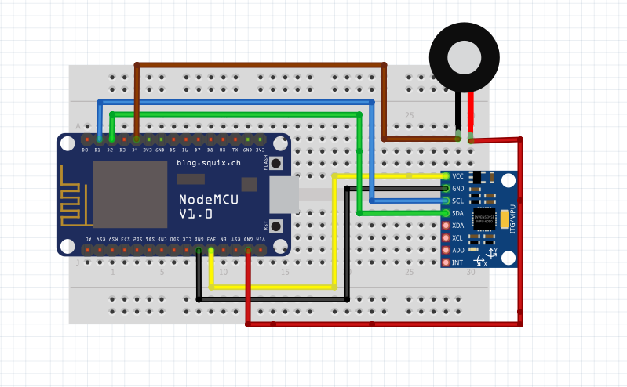
Circuit Diagram

Slide 8

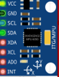

Components
Node MCU ESP8266
Used to analyse data for sensor and send notification to the user and ring buzzer in case of an emergency
MPU 6050
Used to sense acceleration and angular rotation of the wheelchair
Buzzer
Used to alert people around the patient

Slide 9
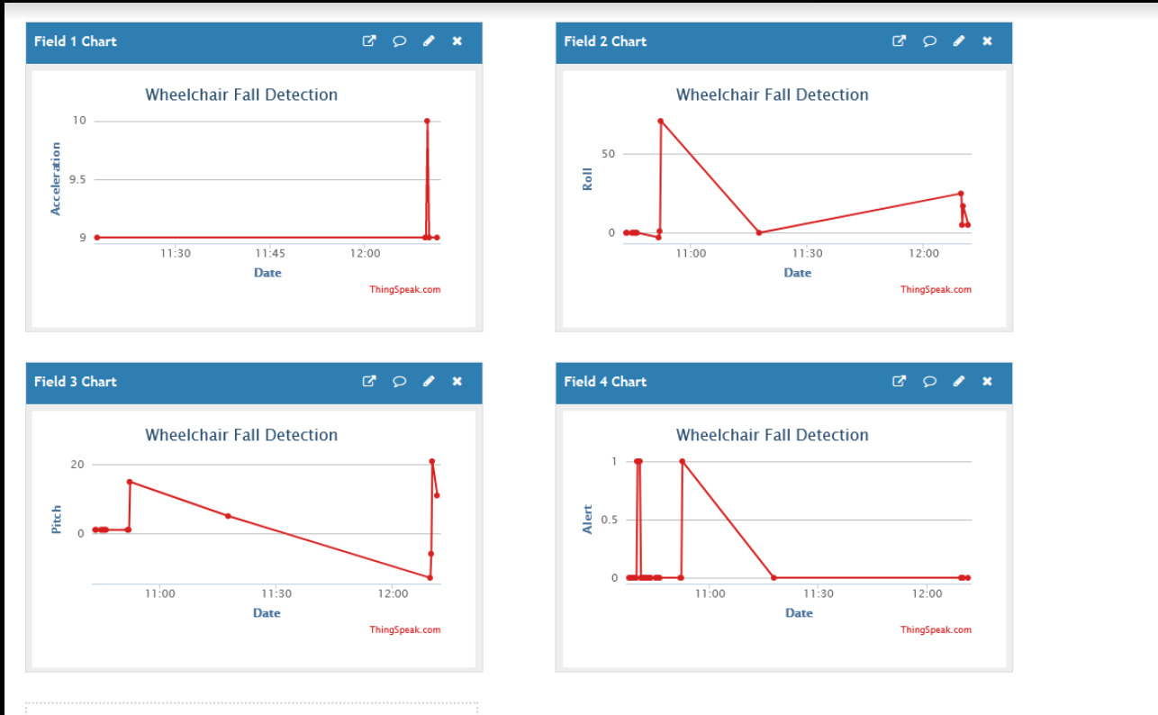
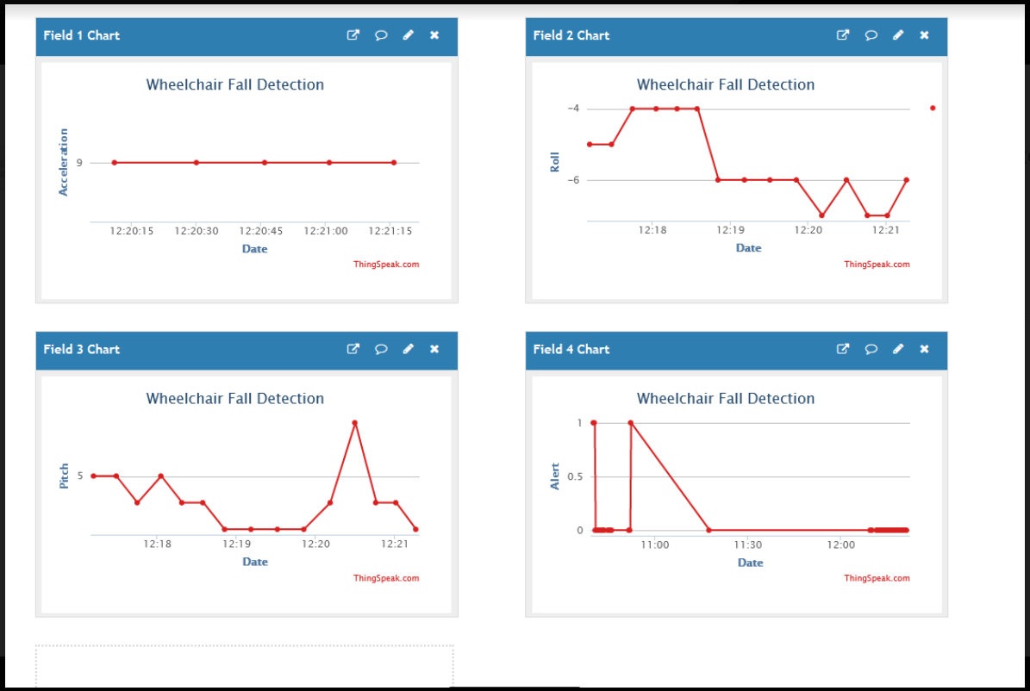
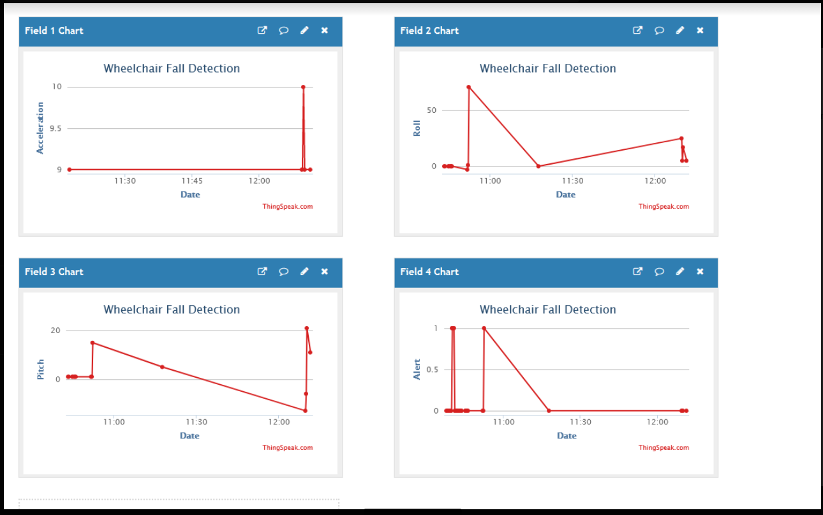
Test Plots

Slide 10

Results

Slide 11
Implementation Details
The system MPU 6050 6 pin accelerometer and gyro meter to detect person movements,
The sensor along with Node MCU ESP8266 board will be fixed on the wheelchair itself.
The sensor is connected to a microcontroller in order to constantly transmit the acceleration data.
Now the system keeps monitoring for fall detection and abrupt movement changes in person.
A sudden abrupt change in acceleration or angular velocity beyond threshold values are considered as a fall
Now in case the person did not fall and alarm was false, the system allows to snooze the alert if person presses snooze button in 5 seconds.
If person does not press the snooze, system detects person has fallen and automatically triggers alert through Wi-Fi connection using the ESP 8266 Wi-Fi module to alert the loved ones of the person about the situation instantly.

Slide 12
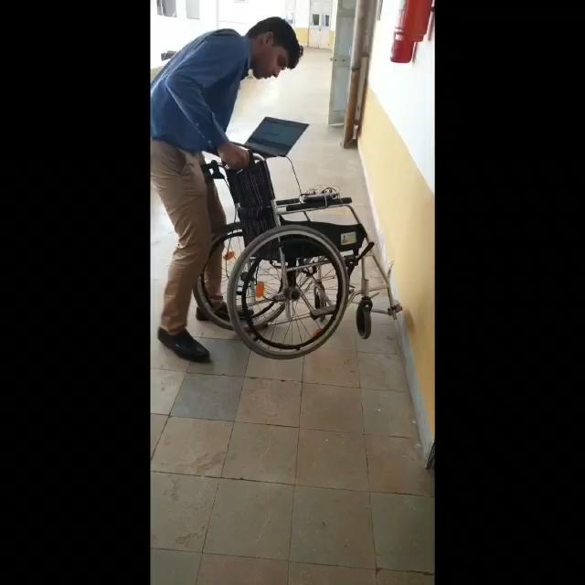
Video

Slide 13
CONCLUSION
In this project we have successfully made a wheelchair fall detection system using Arduino and esp 8266.
This system measures the acceleration, roll and pitch of the wheelchair to determine a fall.
Our project is only constrained by the range of Wi-Fi signal picked up by the Esp 8266.
Future Scope :
Wheel chair patients GPS location in case of accident
SMS or message sending to nearest hospital or doctor
With the use of ML, we could further determine better threshold values or behavior of the constraints that are commonly observed in a fall.

Slide 14
References
S. A. Waheed and P. Sheik Abdul Khader, "A Novel Approach for Smart and Cost Effective IoT Based Elderly Fall Detection System Using Pi Camera," 2017 IEEE International Conference on Computational Intelligence and Computing Research (ICCIC), 2017, pp. 1-4
Geilen BG, de Witte L, Norman G, George CE. Quality of wheelchair services as perceived by users in rural Bangalore district, India: a cross-sectional survey. Disabil Rehabil Assist Technol. 2020 Nov 27:1-9.
M. A. Rahman, S. M. Ahsanuzzaman, A. Hasan, I. Rahman, T. Ahmed and M. M. Kadir, "Building A Wheelchair Controlling and Fall Detection System Using Mobile Application," 2020 2nd International Conference on Advanced Information and Communication Technology (ICAICT), 2020, pp. 213-218,
Abdulla, Raed & Kumar Selvaperumal, Assoc. Prof. Dr. Sathish & Nataraj, Chandrasekharan "WHEELCHAIR-PERSON FALL DETECTION WITH INTERNET OF THINGS" Solid State Technology. 63. 911-922.
Devanch Kumar Garg, Gauri Rao, "An IOT based fall detection system" International Journal of Innovative Technology and Exploring Engineering (IJITEE)ISSN: 2278-3075, Volume-9 Issue-6, April 2020
Laura A. Rice, Alexander Fliflet, Mikaela Frechette, Rachel Brokenshire, Libak Abou, Peter Presti, Harshal Mahajan, Jacob Sosnoff, Wendy A. Rogers,"Insights on an automated fall detection device designed for older adult wheelchair and scooter users: A qualitative study", Disability and Health Journal,Volume 15, Issue 1, Supplement, 2022,
Sayali M. Kamble , Pratiksha R. Kawle, Suwarna S. Mohile, Megha R. Meshram, Prof. Gayatri Padole Mam, Neetu Gyanchandani Mam, "IOT Based Person/Wheelchair Fall Detection System", International Journal for Research in Applied Science & Engineering Technology (IJRASET) Volume 10 Issue II Feb 2022
Beston, Tshibamb & Natarajan, Thangadurai. (2019), “Recent Trends in Wheelchair to Assist the Physically Challenged”, International Journal of Recent Technology and Engineering. 8. 488-491. 10.35940/ijrte.B1553.078219.

